Slide 1
Cyclistic (bike-sharing)
October 17, 2021

Slide 2
Overview
Cyclistic is a bike-share company with more than 5,800 bicycles launched in 2016. The company has 692 stations spread across Chicago.
The company has flexible pricing plans:
Single-ride passes
Full day passes
Annual membership
Customers with single-ride or full-day passes are referred to as casual riders, whereas those who purchase annual memberships are members.

Slide 3
Business task
Question 1?
Question 2?
How do annual members and casual riders use Cylisitc bikes differently? (marketing analytics team to investigate)
How can we use digital media to influence casual riders to become members? (Answer mainly directed at the executive team)

Slide 4
Data

Slide 5
Data
The data is downloaded from https://divvy-tripdata.s3.amazonaws.com/index.html. These data are original and current.
I have downloaded the latest data file, collected for Sep 2021 and stored it in my google drive. Since it only spans a month, the data may not be reliable.
The data has been made available for this course. (no need for license)

Slide 6
Analysis

Slide 7
Analysis
Since the data is too large to be processed in excel/google sheet, I will be using R programming language to conduct my analysis.
I have documented the process I took to clean and analyse the data in the file “analysis.Rmd” stored in the site below.

Slide 8
Visualisation

Slide 9
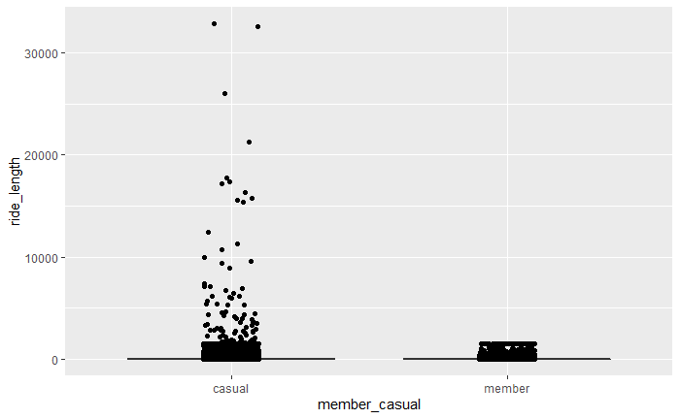
Visualisation
Although there could be outliers for casual users ride durations, the range of the box plot is greater than member users. So, overall we can conclude that casual users ride longer than member users.

Slide 10
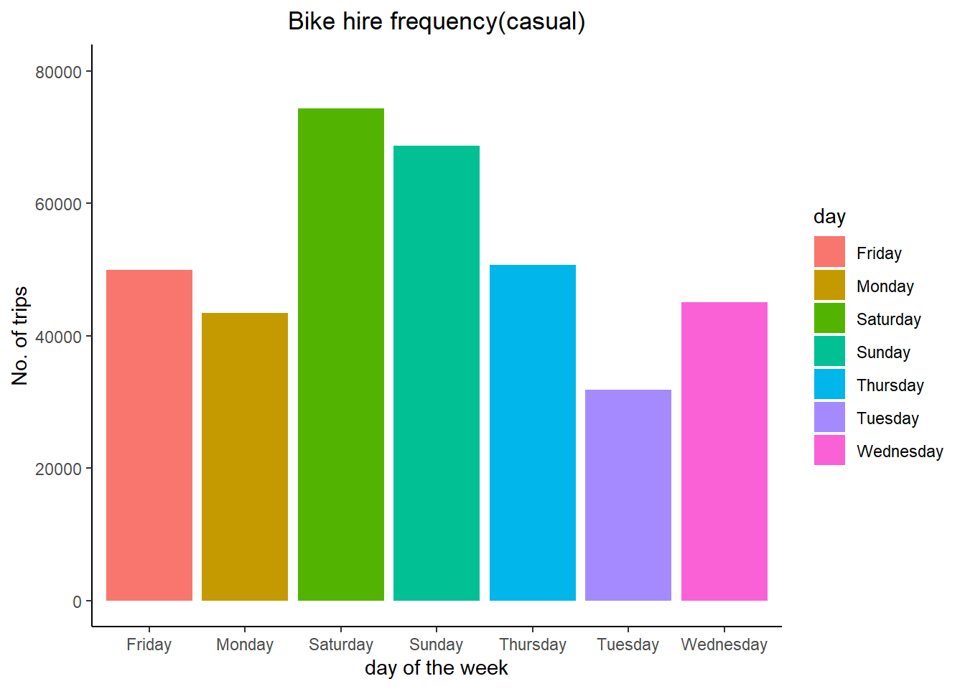
Visualisation
Casual users make more trips during the weekend. Since we already know that most users ride for leisure, carrying out such an activity on the weekend makes sense .

Slide 11
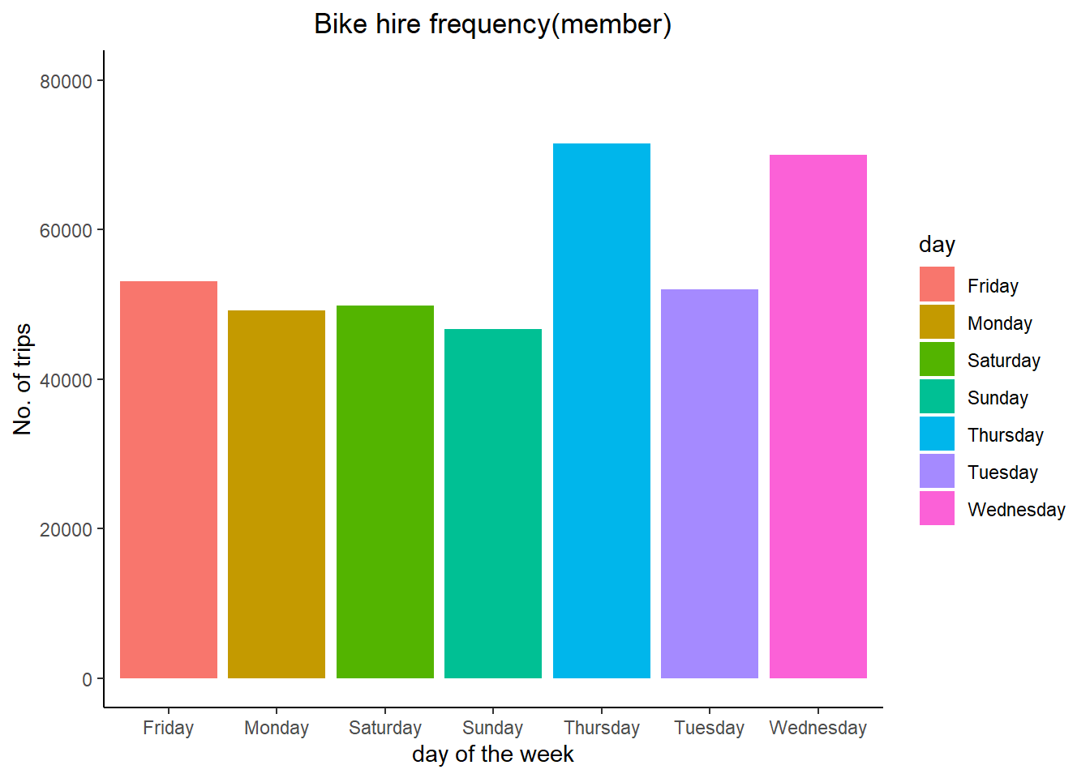
Visualisation
Member users make more trips during weekdays. This is probably due to commuting. So it is a shorter trip, as the rider try to get to work as soon as possible.

Slide 12
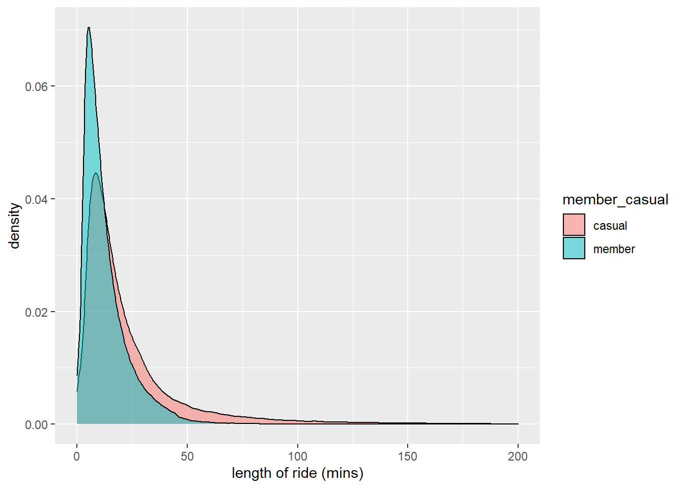
Visualisation
The graph above is the density plot for the length of the ride variable. It visualizes the distribution of the data for this variable. The plot shows that it is more likely for trips made by member user to be shorter than casual users.
This confirms our earlier hypothesis that member users make shorter trips commuting, whereas casual users ride longer for leisure.

Slide 13
Recommendations

Slide 14
Proposed Recommendations
Recommendation 1
Target casual riders that make short trips during the week with social media ads/email offers. These are potential member users who are commuting as casual users for now.
Recommendation 2
Partner with firms around the city offering promotional discounts/trials using our online platforms to attract employees to join as members.
Recommendation 3
Adjust pricing plans to make it cheaper for casual users to become members if they regularly use the scheme to make short trips (commuting). The digital media team can then push such pricing plan offers to target these casual users.

